Slide 1
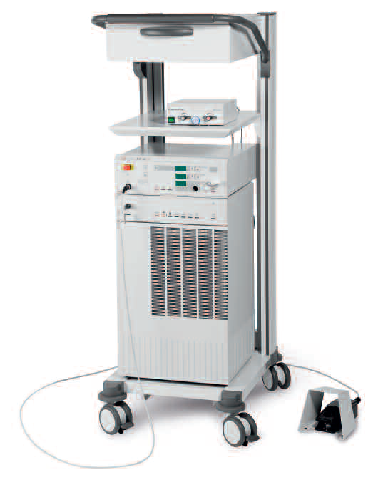
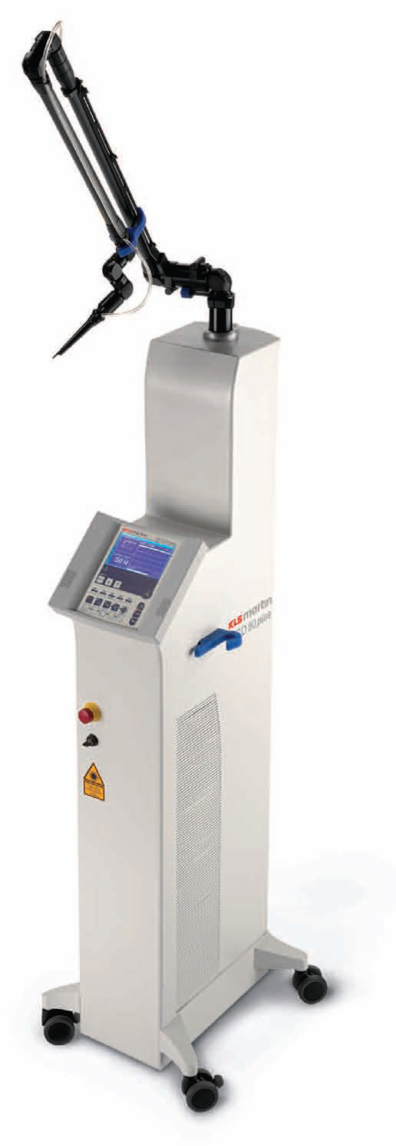
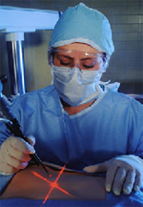
MEDICAL LASER SYSTEMS
Assist Prof. Dr. Lutfi Ghulam Awazli
Institute of laser for postgraduate studies
University of Baghdad

Slide 2
TYPES OR CLASSIFICATION OF LASER

Slide 3
TYPES OR CLASSIFICATION OF LASER
Many classifications:
1- ACCORDING TO ACTIVE MEDIUM
( Gas , Solid, Liquid, or a Semi-conductor )
2- ACCORDING TO POWER
( Low power, Intermediate power , High power )
3- ACCORDING TO WAVELENGTH
( Ultraviolet, Visible, or Infrared )
4- ACCORDING TO OUTPUT (NATURE OF EMISSION ) ( Continuous wave ,Pulsed wave laser )
5- ACCORDING TO LASER TECHNIQUE
( Contact and non-contact )

Slide 4
1- ACCORDING TO ACTIVE MEDIUM
Gas Laser :
He-Ne laser, CO2 laser
Solid state laser :
Ruby laser, Nd: YAG Laser
Liquid dye laser:
Pulsed Dye lasers (PDL)
Semiconductor Lasers:
Diode Lasers

Slide 5
2- ACCORDING TO POWER
CLASS I LASER : Low power lasers usually less than 0.4 mW.
Examples : laser printers, CD players, and diode lasers
CLASS II LASER : Low power lasers { 0.4 -1 mW }.
Examples : laser pointers, range finders
CLASS IIIa LASER : Intermediate power lasers { 1- 5 mW }
Example : laser scanner.
CLASS IIIb LASER : Intermediate power lasers either
CW wave laser power of 5- 500 mW} or pulsed (energy density of less than 10 J /cm²)
Example : dye lasers
CLASS IV LASER : High power lasers include:
(medical laser) CW lasers power of more than 500 mW or
pulsed type lasers with energy density of more than 10 J /cm² . Examples : argon laser and Nd:YAG laser,CO2 laser, …….

Slide 6
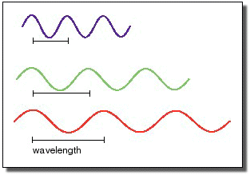
3- ACCORDING TO WAVELENGTH
Laser Type
Wavelength (nm)
Laser Type
Wavelength (nm)
Ultraviolet
Argon fluoride (Excimer-UV)
Krypton chloride (Excimer-UV)
Krypton fluoride (Excimer-UV)
Xenon chloride (Excimer-UV)
Xenon fluoride (Excimer-UV)
Helium cadmium (UV)
Nitrogen (UV)
visible
Helium cadmium (violet)
Krypton (blue)
Argon (blue)
Copper vapor (green)
Argon (green)
Krypton (green)
Frequency doubled
Nd: YAG (green)
Helium neon (green)
Krypton (yellow)
Copper vapor (yellow)
Helium neon (yellow)
Helium neon (orange)
Gold vapor (red)
Helium neon (red)
Krypton (red)
Rohodamine 6G dye (tunable)
Ruby (CrAlO₃) (red)
Infrared
Gallium arsenide (diode-NIR)
Nd:YAG (NIR)
Helium neon (NIR)
Erbium (NIR)
Holmium: YAG (NIR)
Hydrogen fluoride (NIR)
Carbon dioxide (FIR)
Carbon dioxide (FIR)
193
222
248
308
351
325
337
594
610
627
633
647
570-650
694
441
476
488
510
514
528
532
543
568
570
810-980
1064
1150
1504
2100
2700
9600
10600
Key:
UV = ultraviolet (200-400 nm)
VIS = visible (400-700 nm)
NIR = near infrared (700-1400 nm)

Slide 7
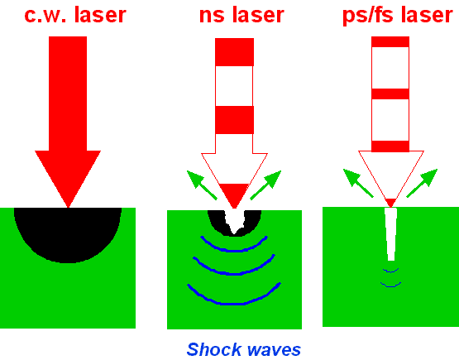
4- ACCORDING TO OUTPUT (NATURE OF EMISSION )
LASER BEAM OUTPUT
Lasers operate in two modes:-
1- Continuous wave mode: (CW mode)
Helium-Neon, Argon, Krypton or CO2 lasers.
2- Pulsed mode : Ruby and Nd:YAG lasers.
Pulsed laser mode may be further subdivided
according to pulse length and methods for
producing such pulses.
- Normal pulsed mode.
- Q-switched mode.
- Mode locked mode.
Power( Watts)
Time
Energy (Joules)
Time

Slide 8
LASER BEAM OUTPUT MODALITIES :
Lasers may be divided into two broad groups:
Continuous wave (CW) mode:
Is one whose power out put undergoes little or no fluctuation with time. It exhibits a steady flow of coherent energy. Typical examples: Helium neon, argon gas and CO2 lasers
The out put of CW lasers is measured as power in watts, referring to the rate at which work is performed, or the energy applied per unit time.
Pulsed mode:
The out put beams undergo marked fluctuations with time.
Nd: YAG and CO2 laser often, but not always, operate in the pulsed mode.
The out put of pulsed lasers is expressed in energy measured in joules. The peak power can then be calculated, equal to output energy/ pulse duration.
Pulsed laser operation may be further subdivided according to pulse length and methods for producing such pulses. The following are the basic operating modes for pulsed lasers: Normal pulsed mode.
Q-switched mode.
Mode locked mode.

Slide 9
Laser Output
Continuous Output (CW)
Pulsed Output (P)
Energy (Joules)
Power (Watts)
Time
Time
The output undergoes little or no fluctuation with time. It exhibits a steady flow of coherent energy. . cutting
The out put beams undergo marked fluctuations with time.
ablation + fragmentation
Examples: He-Ne , argon and CO2 lasers.
Examples: Ruby and Nd:YAG laser
The out put of CW lasers is measured as power in watts (1 watt =1 joule per second),
The out put of pulsed lasers is measured as energy in joules.

Slide 10
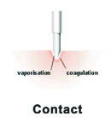
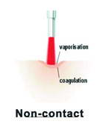
5- ACCORDING TO LASER TECHNIQUE
Laser techniques:-
In general, there are two types of laser techniques, contact and non-contact.
1- Contact technique: There is direct contact between the fiber optic tip and the target tissue.
The tissue absorbs the radiant energy and becomes hot, resulting in the vaporization of the target cells. e.g: Nd:YAG laser
2- Non-contact technique: do not directly touch the tissue. Instead, the laser light transfers radiant energy to the tissue. Heat results when the tissue absorbs the radiant energy and the molecules in the tissue begin to move. e.g: CO2 laser

Slide 11
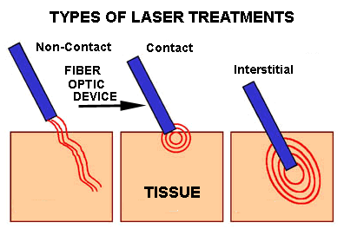

Surface
Interstitial

Slide 12
Carbon-dioxide(CO2) laser
Invented in 1964 by Chandra K. N. Patel at Bell Labs.
Specifications:-
Type: Gas laser
Wavelength: Far infra-red (10600 nm).
Output: Generally available as continuous wave
(s.t as pulsed mode) in noncontact mode.
Delivery system: seven articulated arms
Medical applications:
- it cuts and coagulates the tissue at the same time.
It is called ( A laser scalpel ) because it cut the tissue by the high energy of laser light with very little or no effects on surrounding tissue.
- A laser beam also ablates or vaporizes the soft tissue with high water content. It ablate thin layers, one after the other, with no damage to underlying structures.
CO2 LASER

Slide 13
CO2 LASER

Slide 14
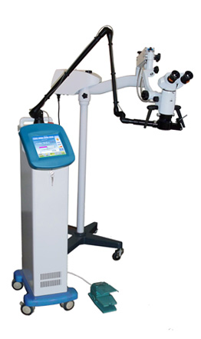
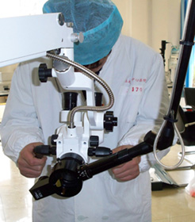
CO2 laser microscopic surgery
Can be used in delicate surgery:
- Neurosurgery,
- E.N.T,
- Ophthalmology ,
- Gynecology,
- Vascular surgery.
……………..
Ultra pulse CO2 laser microsurgery system is made up of:-
Super pulse CO2 laser instrument,
Binocular operating microscope and Micromanipulator.

Slide 15
CO2 LASER

Slide 16
CO2 LASER

Slide 17
CO2 LASER

Slide 18
CO2 LASER

Slide 19
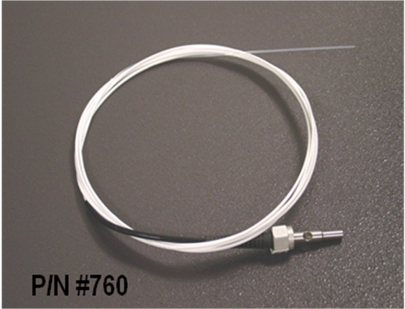
Nd:YAG Laser
Neodymium : Yttrium Aluminum Garnet laser
Invented in 1961 by Leo F. Johnson at Bell Labs
Specifications:-
Type: A solid state laser.
wavelength :1064 nm (Near infra-red).
Output: Available as CW or pulsed in contact mode
Delivery system: Fiber optic
Medical applications:
It is used in surgery for:
• Hoemeostasis
• Tumor ablation
• Vaporization of pathologic tissue
Fiber optic
- It is used in open and endoscopic surgery
Nd:YAG Laser

Slide 20
Nd:YAG Laser

Slide 21
Nd:YAG Laser

Slide 22
Nd:YAG Laser

Slide 23
Nd:YAG Laser

Slide 24
Diode Laser
Invented in 1962 by Robert Hall at General Electric.
Type: Semiconductor Lasers
Wavelengths: Infra-red (810nm, 940nm, 980nm)
Operating modes: continuous (CW) and pulsed. . In contact or non-contact mode.
Delivery system: Fiber optic
Medical applications:
its excellent absorption in hemoglobin, melanin and water.
it can be used for open as well as endoscopic or endoluminal applications
Diode Laser

Slide 25
ENT Surgery
• Vascular anomalies
• Nasal polyps/tumors
• Nasal concha vaporization
• Tonsillectomy
Maxillofacial Surgery
• Mucosal diseases
• Oral tumors
Dermatology/Vascular surgery
• Vascular anomalies
• Hemangiomas
• Nevi
• Tumors
• Warts
General Surgery
• Endoscopy
• Laparoscopy
• Gynecology
Endovenous Laser Treatment (EVLT)
• Great saphenous vein
• Small saphenous vein
• Branch varices
Diode Laser( diomax)

Slide 26
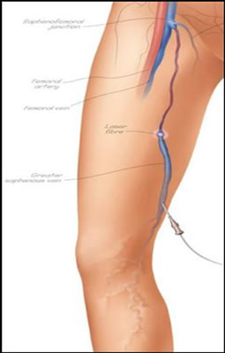
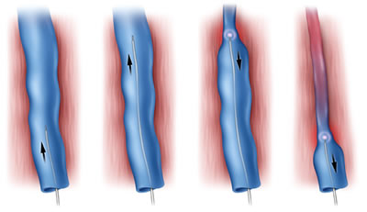
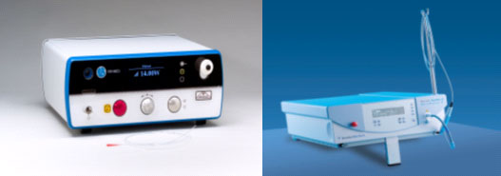
Endovenous Laser Treatment (EVLT)
Diomed Delta Laser
Dornier D940 Laser

Slide 27
Diode Laser in dental surgery

Slide 28
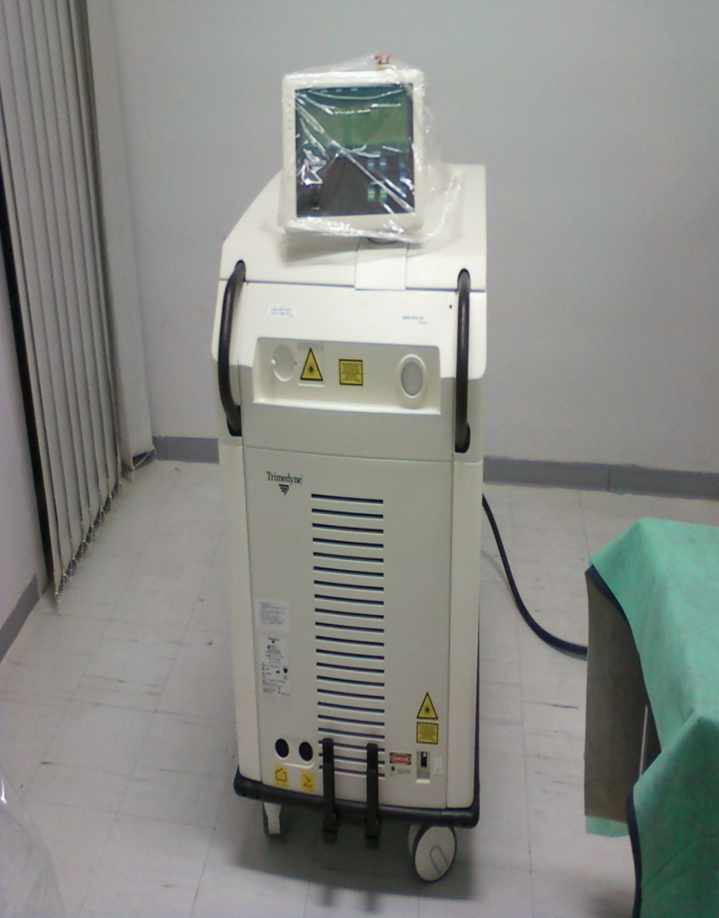
Holmium (Ho):YAG laser
(Ho:YAG) solid state, pulsed | Laser type
2100 nm | wavelength
350 μsec | Pulse duration
0.2 -3.5 J | Energy Range per pulse
80 watt | Maximum power
Red diode laser 635 nm, continuous maximum power (5 mW) | Aiming Beam
Single pulse mode (5-60 HZ) and Double pulse mode (3-30 HZ) | Lasing mode
Trimedyne holmium optical fiber | Laser Delivery
Self-contained water to air heat exchange to ambient air | Cooling
303 Kg (670 Ib) | Approximate weight

Slide 29
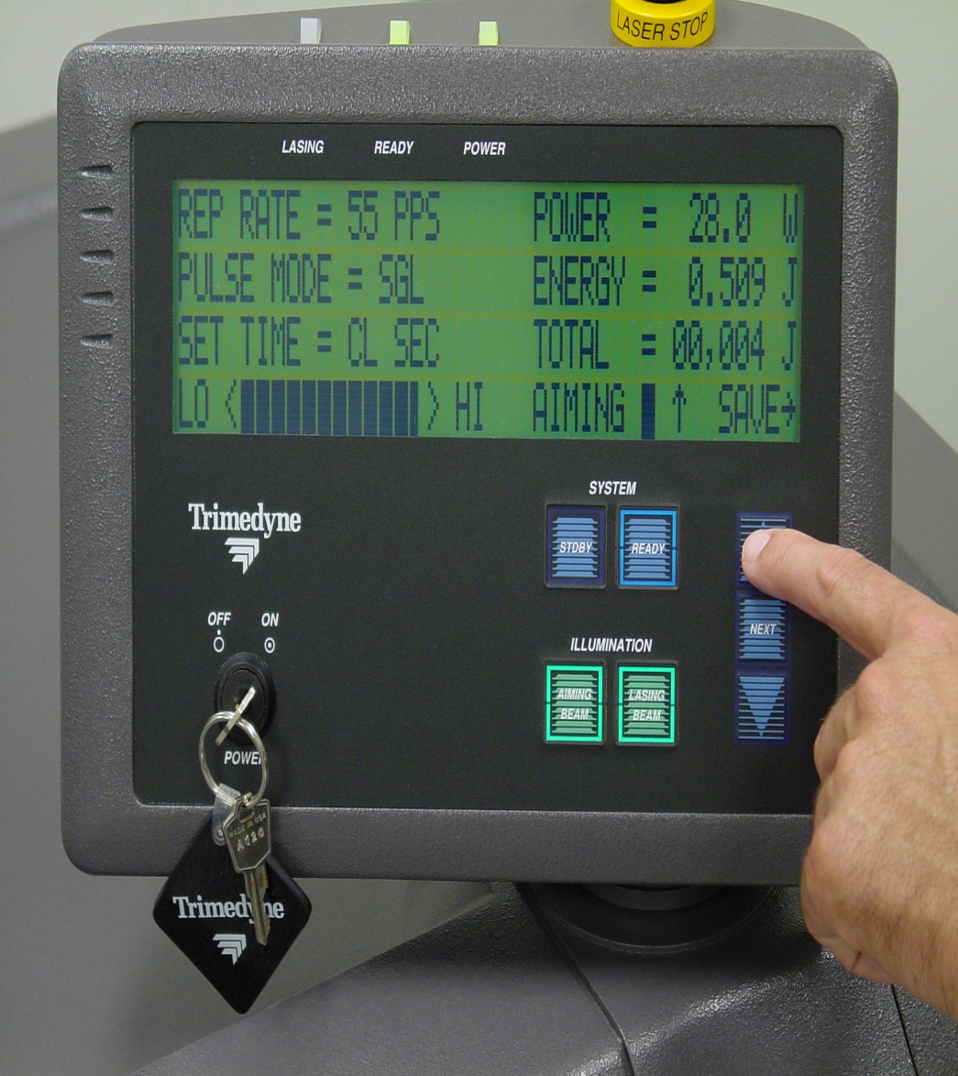
2
3
The four adjustable laser parameters include:-
1. Pulse Mode (single /double)
1
2. Pulse Repetition Rate (Hertz)
Single pulse mode ( 5- 60 Hz)
Double pulse mode (3- 30 Hz)
4
3. Power (Watts)
Maximum power 80 watt
4. Set Time (CL or seconds)
Ho:YAG laser

Slide 30
Medical applications of Holmium:Yag laser :
Orthopedic/Arthroscopic Applications:
Intradiscal Decompression
Thermal Annuloplasty
Fatty tissue removal
Discectomy
Foraminoplasty
…………
Urological Applications:
Ureteral Stone
Badder Stones
Kidney stones
Bladder Tumor
Ureteral Tumor
Condyloma Acuminata
Ureteral Stricture
Bladder Neck Contracture

Slide 31
Parameters of Laser Radiation:
Wavelength (nm) : Absorption + Depth of Penetration
Power( P ): The rate at which the energy is delivered (W)
Exposure time (t) :
Pulse duration, (s)
Energy( E )= P x t
Spot size (cm).
Power Density (Irradiance)=P/A (W/cm²)
Energy density (Fluence)= E/A (j /cm²)
PRR is the pulse repetition rate,( i.e: number of pulses per second )

Slide 32
